Slide 1

Building a dApp on Sui
Understand the process of building dApps on Sui, including smart contract development, front-end integration, and wallet connectivity.

Slide 2
Agenda
Connecting Front-End to Sui Smart Contracts
Wallet Integration
Building an NFT Minting App
Building a Basic DeFi App
Practical Exercises

Slide 3
Connecting Front-End to Sui Smart Contracts
Sui TypeScript SDK
dApp Kit for React
Example Usage
Low-level blockchain interaction
Call smart contract functions
SuiClientProvider for network
WalletProvider for wallet management
ConnectButton for user login
Wrap app with providers; use ConnectButton; get wallet address

Slide 4

Wallet Integration
Wallet Role
dApp Kit Usage
Developer Tip
Sign transactions, manage user assets
WalletProvider + ConnectButton for seamless connection
Access wallet info with useCurrentAccount hook

Slide 5

Building an NFT Minting App
Smart Contract
Mint Function
Front-End
Define NFT struct with key and store attributes
Transfer newly created NFT to sender
Use SDK/dApp Kit to call mint with metadata
*Example code available for Move and JavaScript implementations.

Slide 6
Building a Basic DeFi App
Lending Pool Smart Contract
Front-End Interface
SDK
Integration
Define lending pool struct
Deposit, borrow, and repay functions
Interest handling included
Deposit SUI page
Borrow using collateral
Repay loan page
Invoke contract functions from UI

Slide 7
Optimizing Front-End Integration
React Hooks
Provider Wrapping
User Experience
Use hooks for state and account management
Wrap app with SuiClient and Wallet providers
Show wallet connection status & error handling

Slide 8
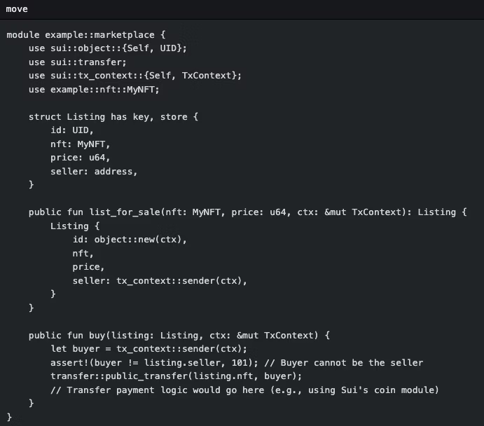
Practical Exercises
NFT Minting App
Move code for NFT struct, Typescript for front-end mint call
Building a Basic DeFi App
Using SDK: Call smart contract functions from front-end for deposits, borrows, repays
(https://mirror.xyz/greymate.eth/_P2NXvVoh9wISj_mqgavDymIERCnW2DgC1gigJNrmUI)
(https://docs.sui.io/guides/developer/app-examples)

Slide 9
Thank You.

